Slide 1

Online Doctor Appointment &
Health Record System
CSA4308 — Internet Programming
Presented by:
Suharshitha Hima Harshitha
Pallavi
Sameera
Neelima
Faculty:
K . Raja Gopal

Slide 2


ABSTRACT
• The system provides an online platform for patients to book doctor appointments easily.
• Patients can view doctor details, available slots, and appointment status.
• Doctors can manage appointments and access patient health records.
• Medical history, prescriptions, and appointment details are securely stored in a database.
• The system reduces manual work and provides quick access to healthcare information.

Slide 3


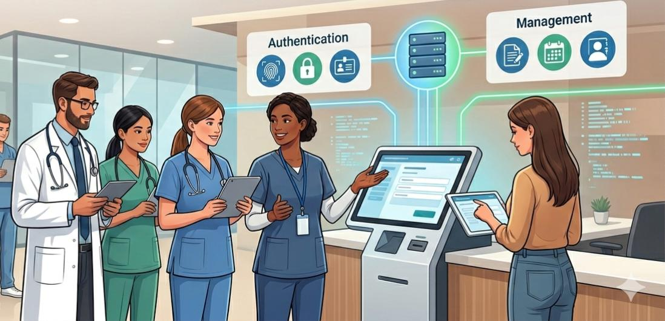
INTRODUCTION
• The Online Doctor Appointment & Health Record System is a web-based healthcare platform. • It allows patients to book appointments with doctors online. • Patients can access their medical history, prescriptions, and appointment details. • Doctors can manage appointments and view relevant patient information. • The system reduces paperwork and makes healthcare management faster and easier.

Slide 4
PROPOSED SYSTEM
• Develop a single web-based platform for online appointment booking and health record management. • Patients can register, view doctors, select available slots, and book appointments. • Doctors can manage appointments and update patient medical records. • The system stores patient details, medical history, prescriptions, and appointment information in a database. • This provides secure, organized, and easy access to healthcare information.

Slide 5
LITERATURE REVIEW
Title | Author | Year | Problem Solved | Advantages | Disadvantages
Online Appointment Scheduling System | Mazaheri Habibi et al. | 2019 | Long waiting time & no-shows | Reduces waiting time | Requires internet access
e-Appointment Scheduling Service | Zhang et al. | 2014 | Traditional appointment difficulties | Convenient booking | Low digital literacy
Web-Based Patient Portal | Patient Portal Study | 2020 | Missed appointments & communication | Improves satisfaction | Requires user familiarity
Electronic Health Record Access | Systematic Review | 2020 | Limited access to medical records | Better patient involvement | Privacy concerns
Online Appointment Scheduling | Kammrath Betancor et al. | 2024 | Inefficient appointment management | Reduces no-shows & improves utilization | Adoption varies by users

Slide 6
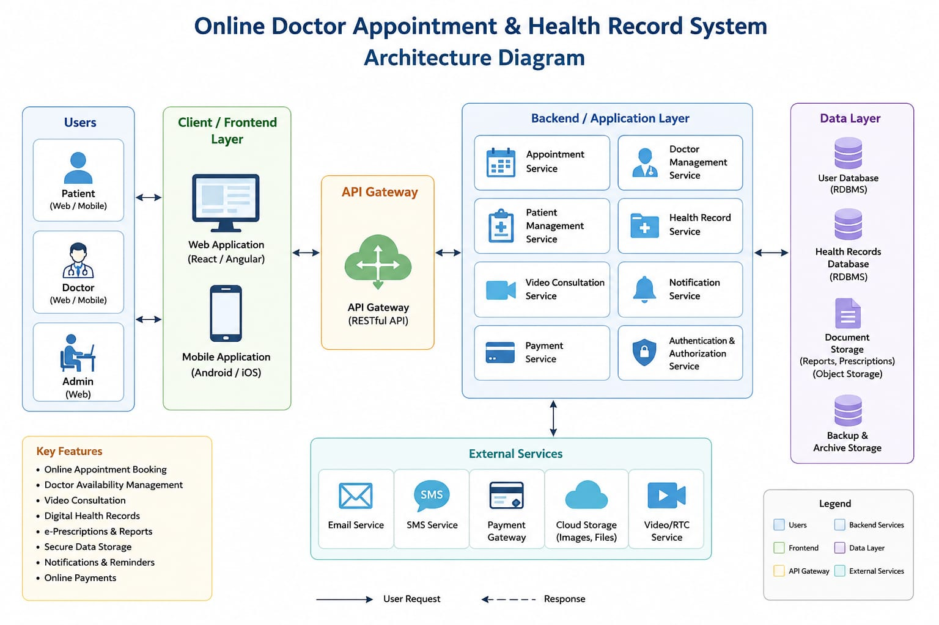
SYSTEM ARCHITECTURE

Slide 7
Module 1 – Doctor Search & Appointment Booking
Allows patients to search for doctors based on specialization and availability.
Displays doctor information such as name, specialization, experience, and available time slots.
Patients can select a suitable date and time for consultation.
Provides online appointment booking and cancellation facilities.
Displays the current appointment status to patients and doctors.

Slide 8
Module 2 – Electronic Health Record (EHR) Management
Maintains patient medical information in a centralized digital record.
Stores medical history, diagnosis, prescriptions, and treatment details.
Doctors can update patient records after each consultation.
Patients can securely view their previous medical records.
Reduces paperwork and makes health information easier to access

Slide 9
Module 3 – Admin Dashboard & Analytics
Provides an administrative dashboard to manage the overall system.
Admin can manage registered patients, doctors, and appointments.
Displays statistics such as total users, appointments, and completed consultations.
Helps monitor system activities and appointment trends.
Provides organized information for better healthcare management.

Slide 10
Module 4 – User Registration & Authentication
Allows patients and doctors to create their accounts on the platform.
Provides secure login and logout functionality.
Uses different access levels for patients, doctors, and administrators.
Allows users to update and manage their profile information.
Protects personal and health-related information from unauthorized access.

Slide 11
Module 5 – Notification & Reminder System
Sends confirmation notifications after an appointment is booked.
Provides reminders before the scheduled doctor appointment.
Notifies patients about appointment changes or cancellations.
Alerts doctors about newly scheduled appointments.
Helps users stay updated and reduces missed appointments.

Slide 12
RESULTS
• Patients can successfully register and book doctor appointments online. • Doctors can view and manage scheduled appointments. • Patient health records can be stored and retrieved efficiently. • The system reduces manual paperwork and appointment management time. • Overall, it provides a convenient and organized healthcare experience.

Slide 13
CONCLUSION
• The system provides an effective solution for online appointment booking and health record management. • It connects patients and doctors through a simple web-based platform. • Centralized health records improve accessibility and reduce manual record handling. • The system makes healthcare management more convenient, organized, and efficient.

Slide 14
FUTURE SCOPE
• Mobile application for Android and iOS. • Online video consultation with doctors. • Automated appointment reminders and notifications. • AI-based health assistance and personalized recommendations. • Integration with digital prescriptions and laboratory reports.

Slide 15


